Slide 1
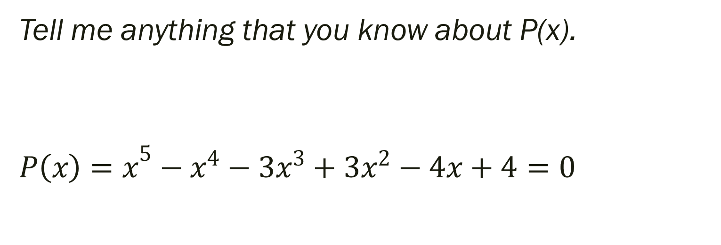
Bell Work
Tell me anything that you know about P(x).
$${P\left(x\right)=x}^{5}−x^{4}−3x^{3}+3x^{2}−4x+4=0$$

Slide 2
From Last Time…
Pg 157 #55, 59, 61, 67, 69, 75
Pg 146 #48, 51
More so for discussion next time…
Pg 164 #21, 31, 51, 69, 97

Slide 3
Pre-calc trig
Day 16

Slide 4
2.5 Zeros of Polynomial Functions
Objective: Use Fundamental Theorem of Algebra to determine number of solutions and then find the zeros.
HLQ: How does the Fundamental Theorem of Algebra apply to solving 2 step equations?

Slide 5
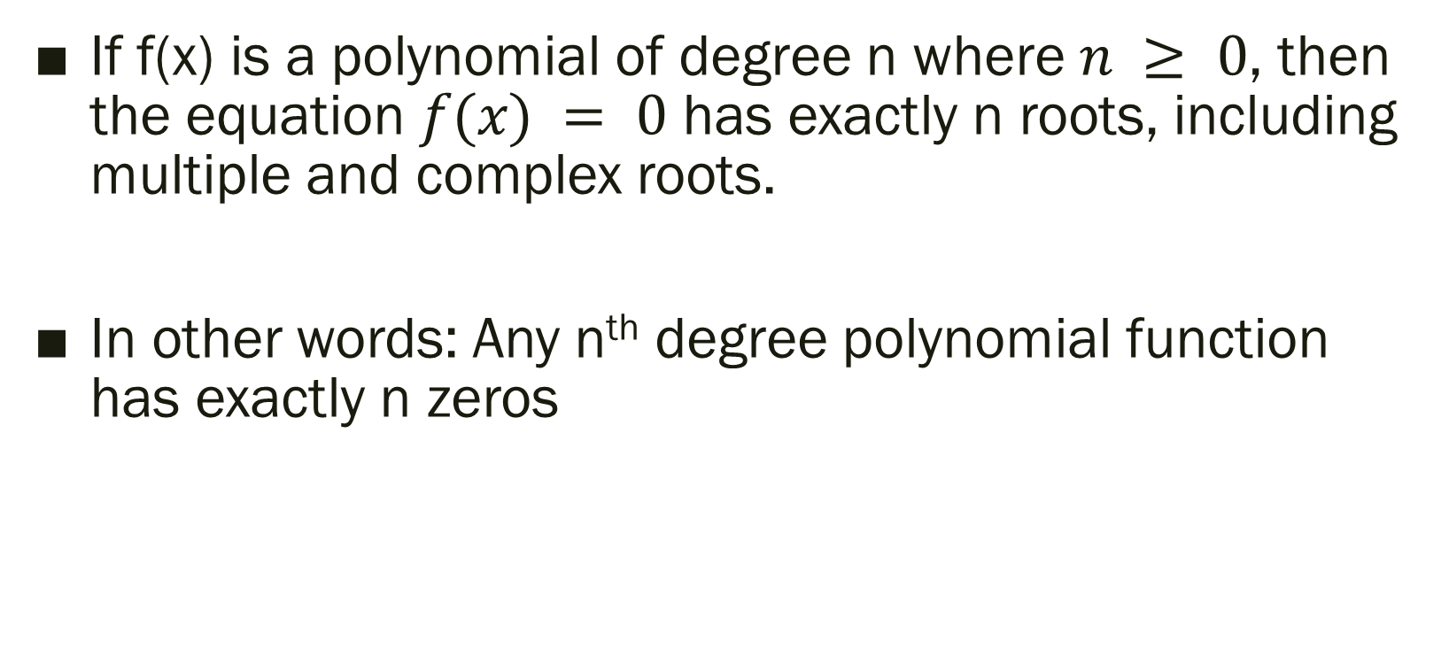
The Fundamental Theorem of Algebra
If f(x) is a polynomial of degree n where $n ≥ 0$, then the equation $f(x) = 0$ has exactly n roots, including multiple and complex roots.
In other words: Any n^{th} degree polynomial function has exactly n zeros

Slide 6
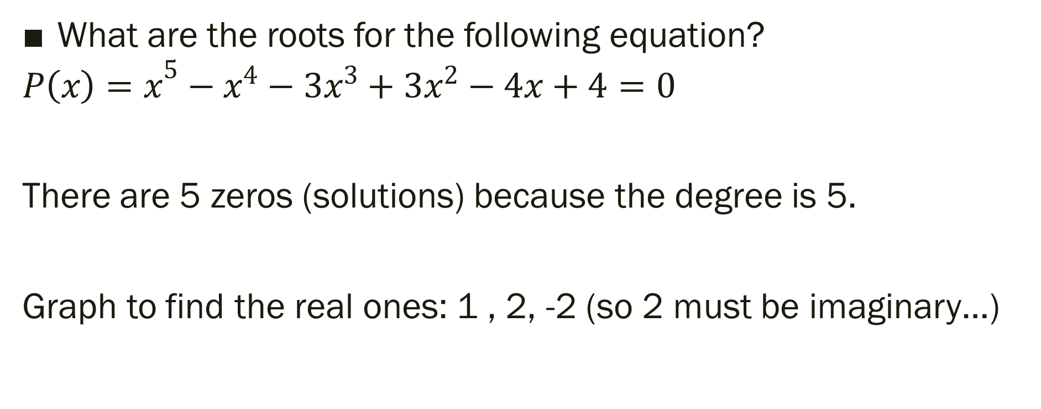
Bell Work Explained:
What are the roots for the following equation?
$${P\left(x\right)=x}^{5}−x^{4}−3x^{3}+3x^{2}−4x+4=0$$
There are 5 zeros (solutions) because the degree is 5.
Graph to find the real ones: 1 , 2, -2 (so 2 must be imaginary…)

Slide 7
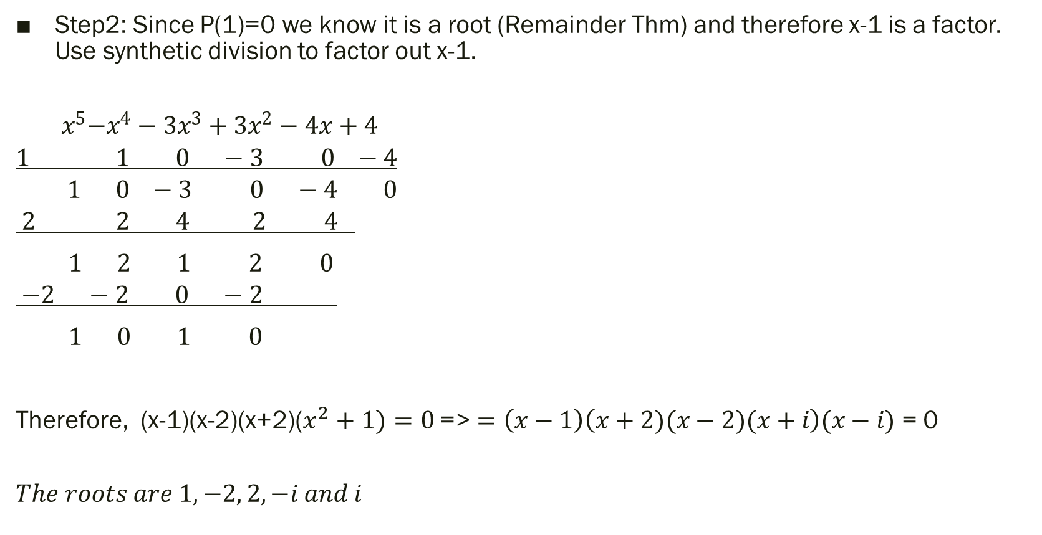
How to find the imaginary:
Step2: Since P(1)=0 we know it is a root (Remainder Thm) and therefore x-1 is a factor. Use synthetic division to factor out x-1.
$${ x}^{5}−x^{4}−3x^{3}+3x^{2}−4x+4$$
$$1 1 0 −3 0 −4$$
$$1 0 −3 0 −4 0$$
$$2 2 4 2 4$$
$1 2 1 2 0$
$$−2 −2 0 −2$$
$1 0 1 0$
Therefore, (x-1)(x-2)(x+2)($x^{2}+1)=0$ => $=\left(x−1\right)\left(x+2)(x−2)(x+i\right)(x−i)$ = 0
$$The roots are 1, −2, 2, −i and i$$

Slide 8

Find all Zeros
$x^{5}−x^{4}−7x^{3}+7x^{2}−18x+18=0$
$x^{4}+2x^{3}−4x^{2}−7x−2=0$

Slide 9
For next time…
Pg 176 #9, 19, 27, 31, 44, 71, 77, 113, 118

Slide 10
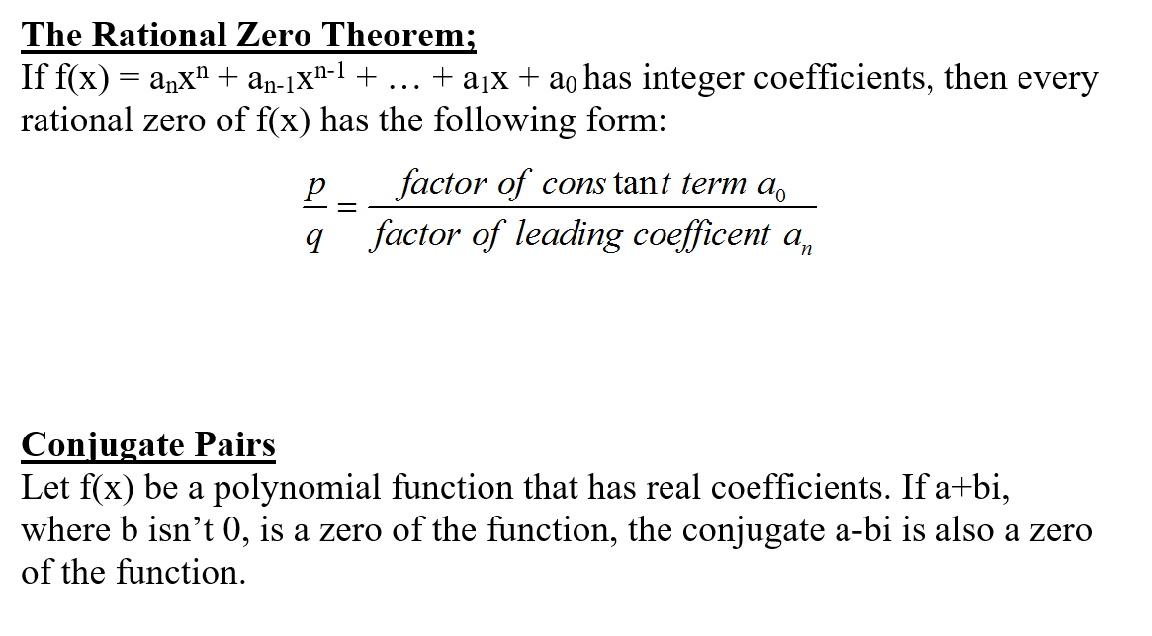
Additional Information

